Slide 1
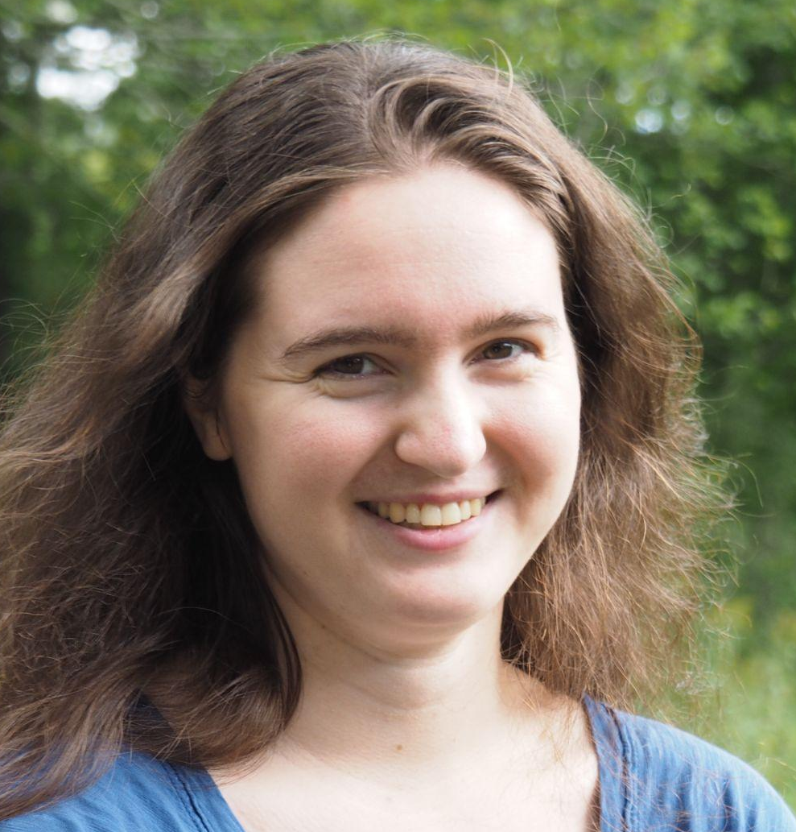
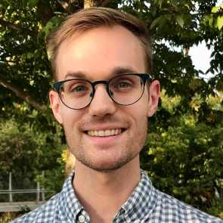


Two’s company but six is a crowd:
emergence of conventions in
multiparty communication games
CogSci 2022
Veronica Boyce, Robert Hawkins, Noah Goodman & Mike Frank

Slide 2
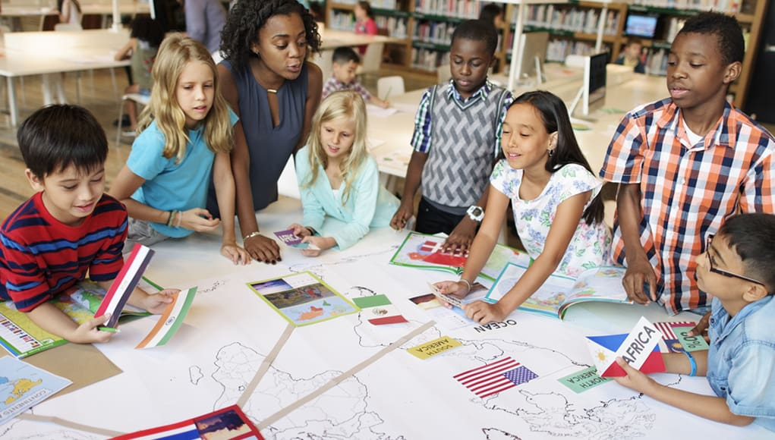

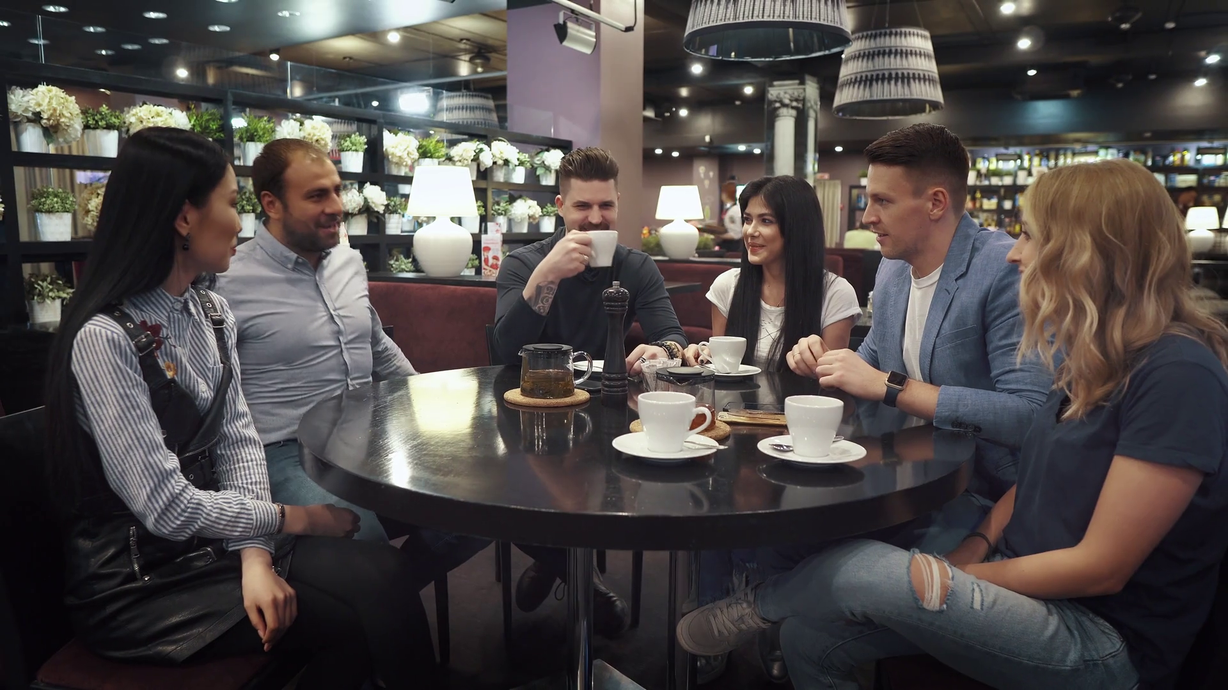
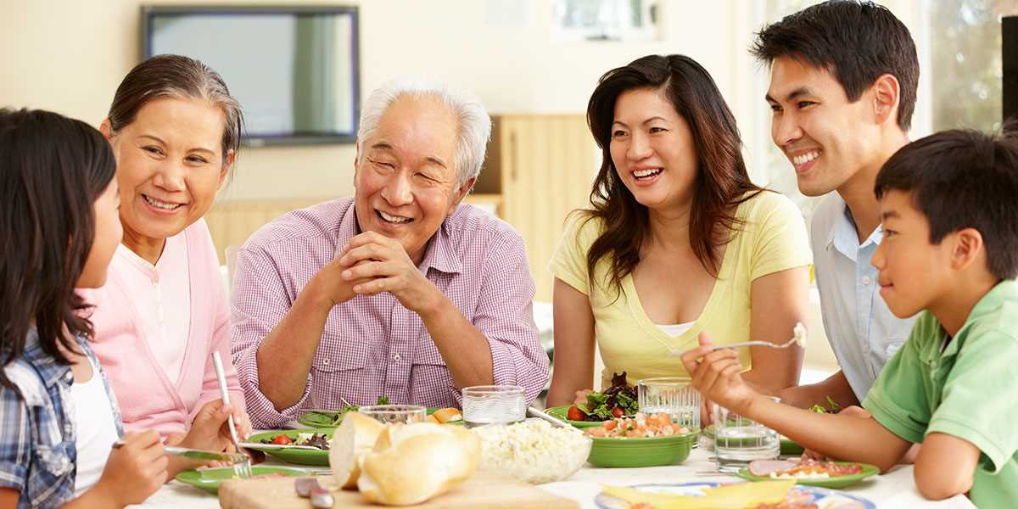
Communication often happens in groups!
Notes:
Lots of meaningful communication happens in groups: from classrooms to negotiations and team meetings.
We also have the intuition that communicating to groups is hard - we actually teach this as a skill in classes, and often struggle to get our meaning across when we give talks or speak to heterogeneous groups.

Slide 3

We typically study dyadic communication
Most prior work has used dyadic referential communication tasks Krauss & Weinheimer 1964, 1966 Clark & Wilkes-Gibbs 1986 Hawkins et al. 2020
It looks like a person sitting down. They’re kinda hunched over and sad-looking.
Facing left? I think I see it.
3-5 person groups primarily studied in context of listeners with different backgrounds Weber & Camerer 2003 Yoon & Brown-Schmidt 2014, 2018, 2019
Here we examine adaptive communication in multi-party tasks
Notes:
But psycholinguists typically study dyadic communication
[read, explain]
… with the goal of understanding how communication works in larger groups.

Slide 4

Key phenomenon: Reduction over repeated reference
Developing a “nickname” for an image over repeated references with the same partner
1st round: I picture someone wrapped in a blanket. You cannot make out their legs or arms. Their upper body is up straight, and it looks like their knees are pointed slightly to the right
6th round: bundle
1st round: it is the one that doesn’t really have anything poking out except at the bottom right is a little triangle shaped almost like a boot
6th round: boot 1

Slide 5

Methods
N=390 Prolific workers
Groups of 2-6 (~15 / size)
6 blocks of 12 targets each (72 trials total)
Rotated speaker between blocks
Empirica platform (Almaatouq et al, 2021)

Slide 6
How does group size affect convention formation?
Does accuracy increase?
How does group size affect reduction?
How do conventions emerge in larger groups?

Slide 7
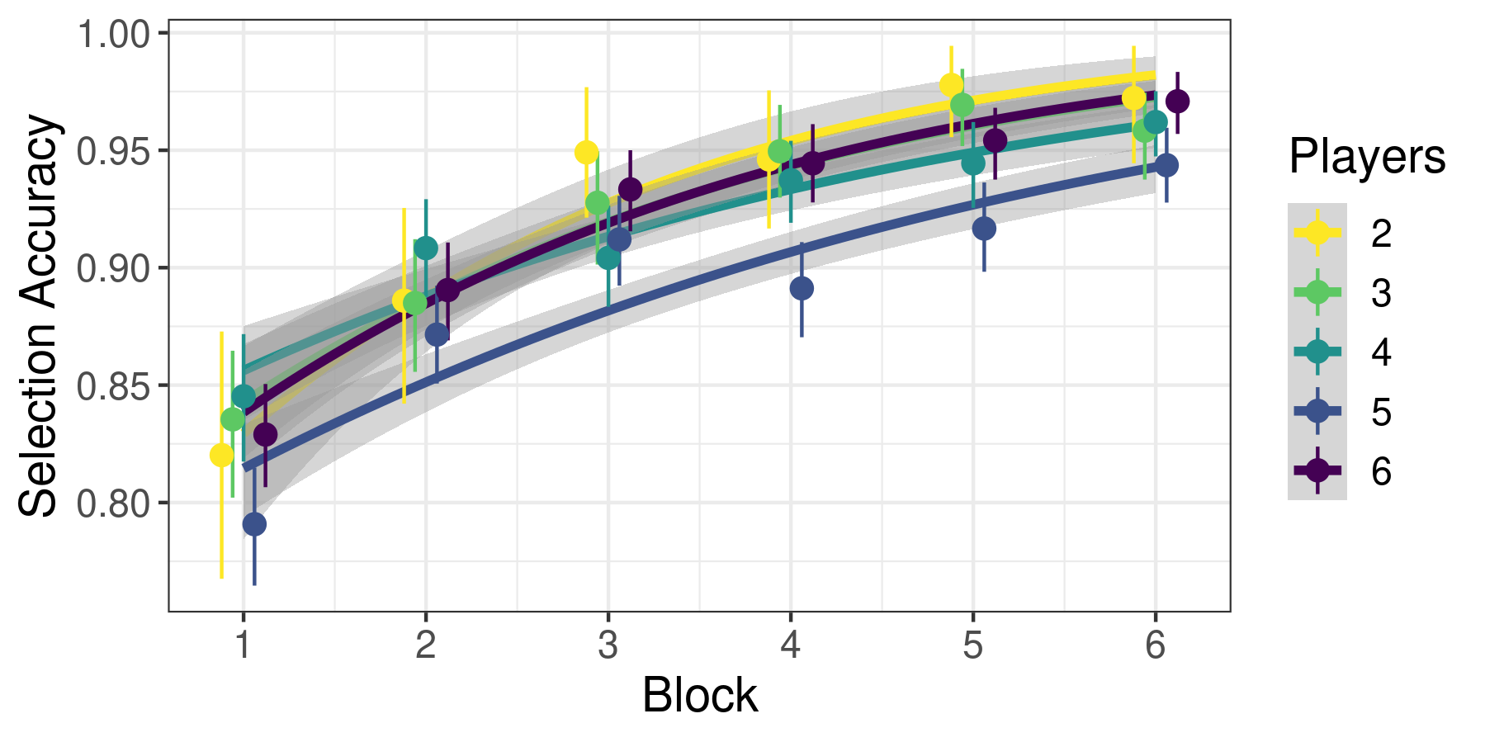
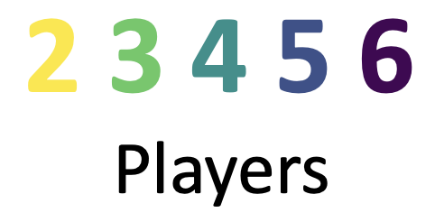
Accuracy is high and increasing
Replication of prior work

Slide 8
How does group size affect convention formation?
Does accuracy increase?
How does group size affect reduction?
How do conventions emerge in larger groups?

Slide 9
How does group size affect convention formation?
Does accuracy increase? | Yes
How does group size affect reduction?
How do conventions emerge in larger groups?

Slide 10
How does group size affect convention formation?
Does accuracy increase? | Yes
How does group size affect reduction?
How do conventions emerge in larger groups?

Slide 11
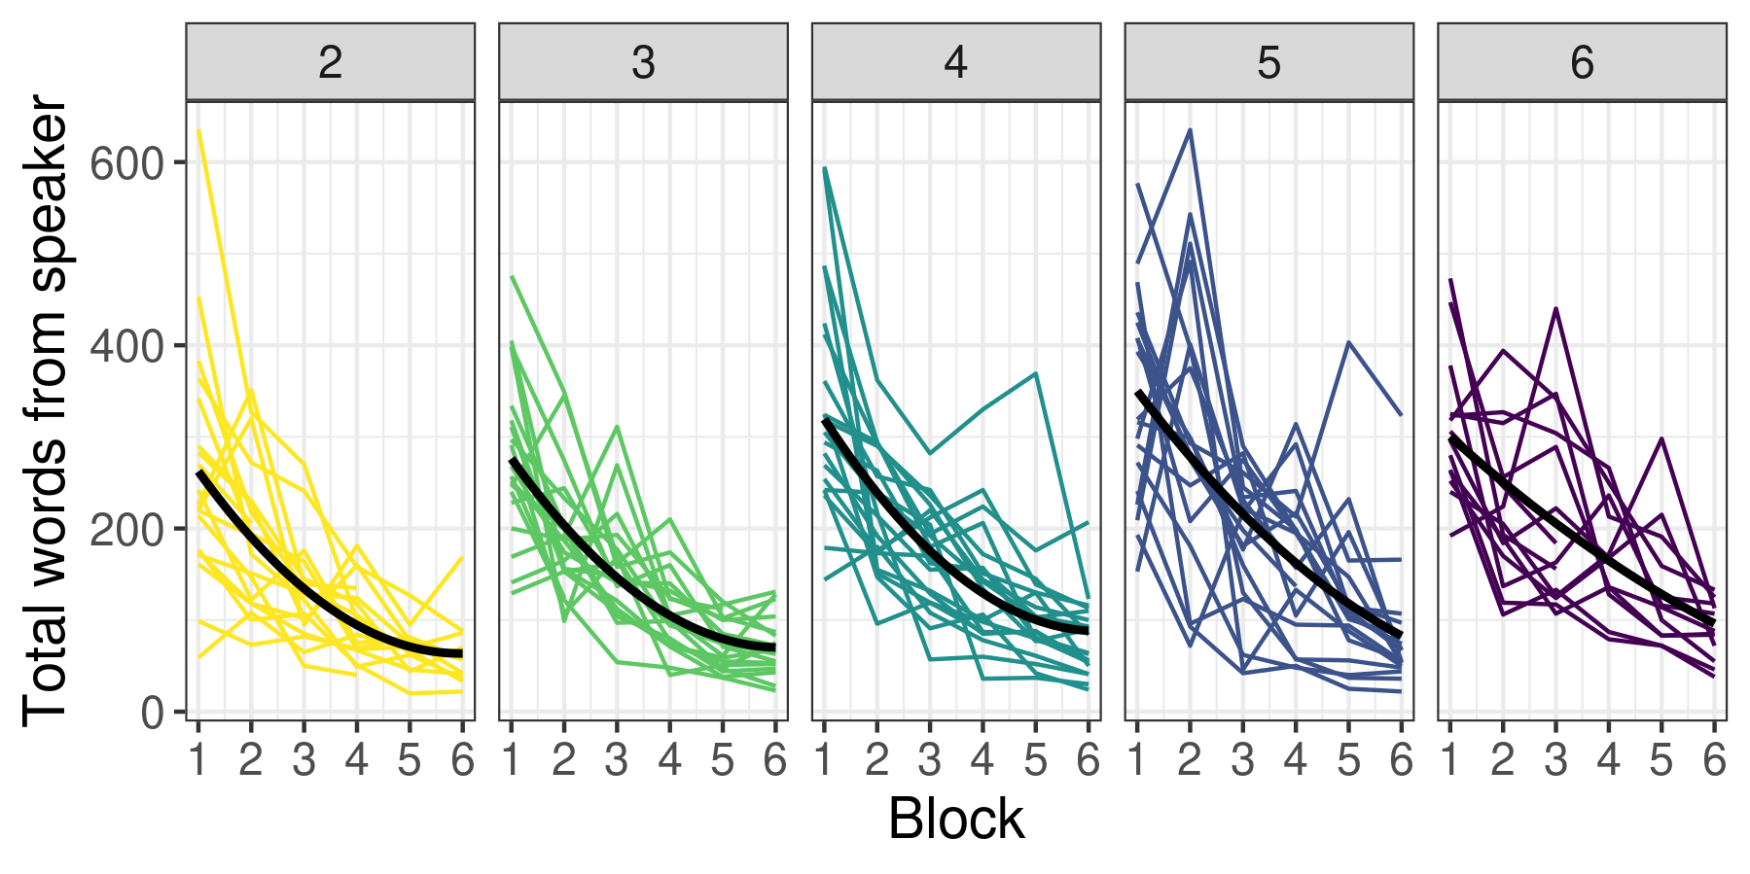
Speakers say less in later blocks
Number of Players

Slide 12
How does group size affect convention formation?
Does accuracy increase? | Yes
How does group size affect reduction?
How do conventions emerge in larger groups?

Slide 13
How does group size affect convention formation?
Does accuracy increase? | Yes
How does group size affect reduction? | Bigger groups say a bit more
How do conventions emerge in larger groups?

Slide 14
How does group size affect convention formation?
Does accuracy increase? | Yes
How does group size affect reduction? | Bigger groups say a bit more
How do conventions emerge in larger groups?

Slide 15

Measuring similarity with sentence embeddings
Turn utterances into vectors with SBERT sentence embeddings (Reimers & Gurevych 2019)
Compute pairwise cosine similarity (smaller angle = bigger cosine)
sentence 1
θ
sentence 2
(4) penguin stomping feet, dinosaur, square head on the right | (6) stomping penguin dinosaur | .83
(4) penguin stomping feet, dinosaur, square head on the right | (5) dinosaur, head tilted backward right | .62
(4) penguin stomping feet, dinosaur, square head on the right | (2) head tilted backward, one leg raised little standing position | .37
(2) head tilted backward, one leg raised little standing position | (6) stomping penguin dinosaur | .14

Slide 16
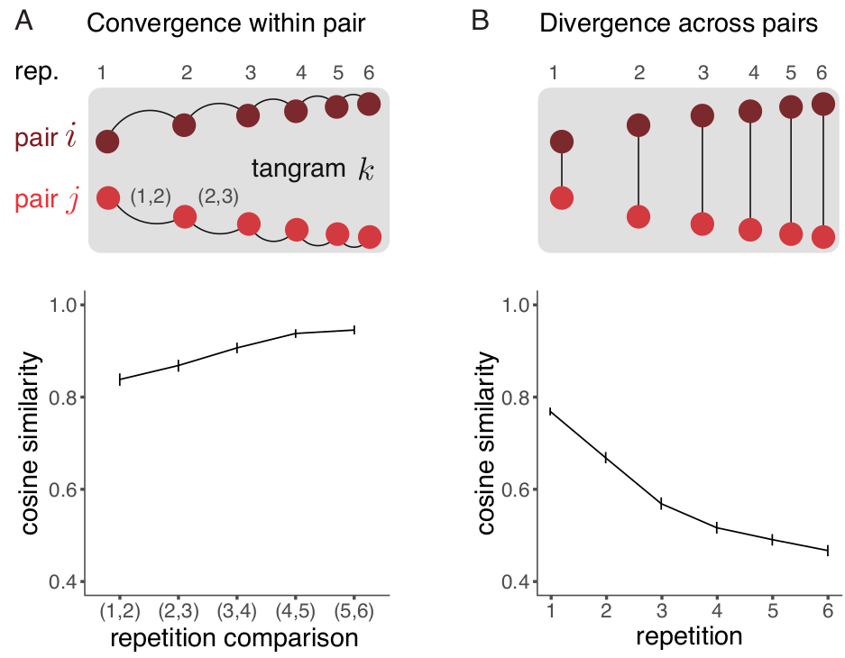

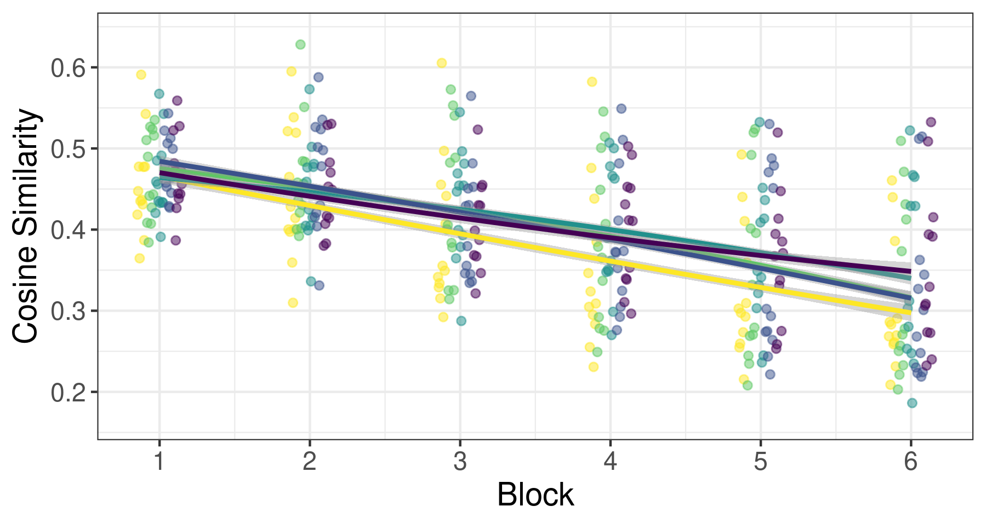
Descriptions diverge across groups
more similar
6-player games, block 5:
slide tackle footballer
abstract one
the same zombie one one arm up one down
The messy one square and triangle on top.
less similar

Slide 17

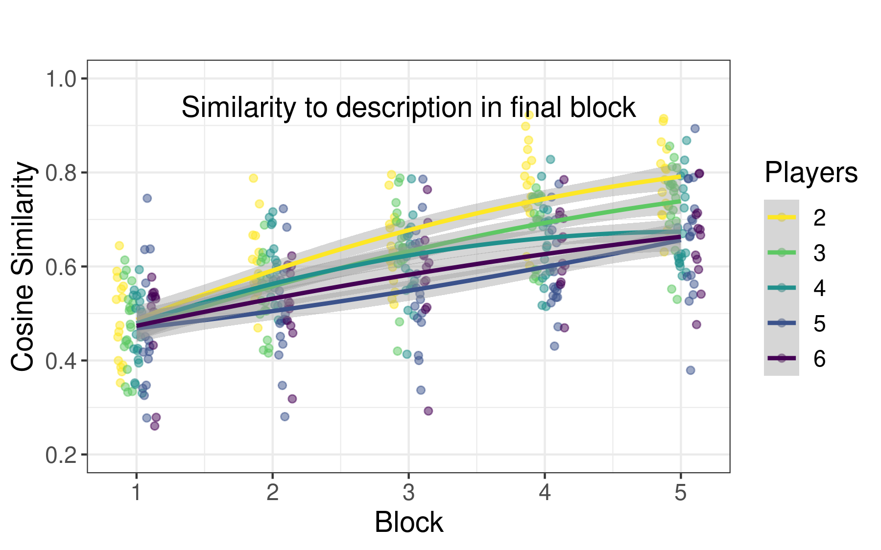
Descriptions converge slower for bigger groups
more similar
Round 3: It's the pope guy, [...]
Round 4: beggar or pope
Round 5: Pope
Round 6: Pope
less similar

Slide 18
How does group size affect convention formation?
Does accuracy increase? | Yes
How does group size affect reduction? | Bigger groups say a bit more
How do conventions emerge in larger groups? | Convergence is slightly slower in larger groups

Slide 19
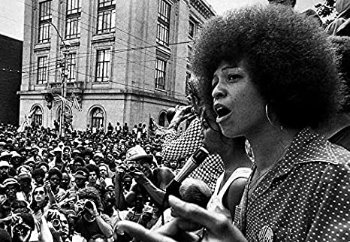


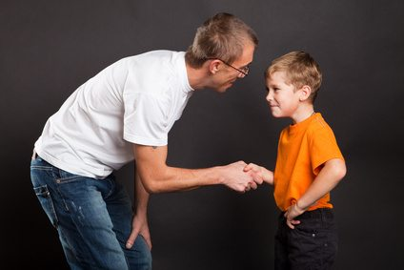
Questions?
More people
Differences in incentives
Differences in knowledge
materials, data, code: github.com/vboyce/FYP
contact: vboyce@stanford.edu
Notes:
Most psycholinguistics has focused on dyadic communication between people with similar knowledge and incentives [small picture]
But communication is very rich!
Communicative situations vary in the number of people that participate (what we studied here). [build]
But they also vary in the incentives and values that the different communicators have (for example, in business negotiations or court rooms).
And they can also vary in the knowledge (and power) that different communicators have
In this study we made a first step towards understanding a little bit of this richness by examining multi-party communication, but in future we hope to explore more of this broad space.

Slide 20
Demographics
Most thought their partners were human (343 yes ,11 no)
Gender: 164 female, 186 male, 4 non-binary
Age: 18-74, mean of 30, 50% in 24-39 range
Race/ethnicity: 284 White, 40 Black, 39 Asian, 12 Hispanic, 1 Native American

Slide 21
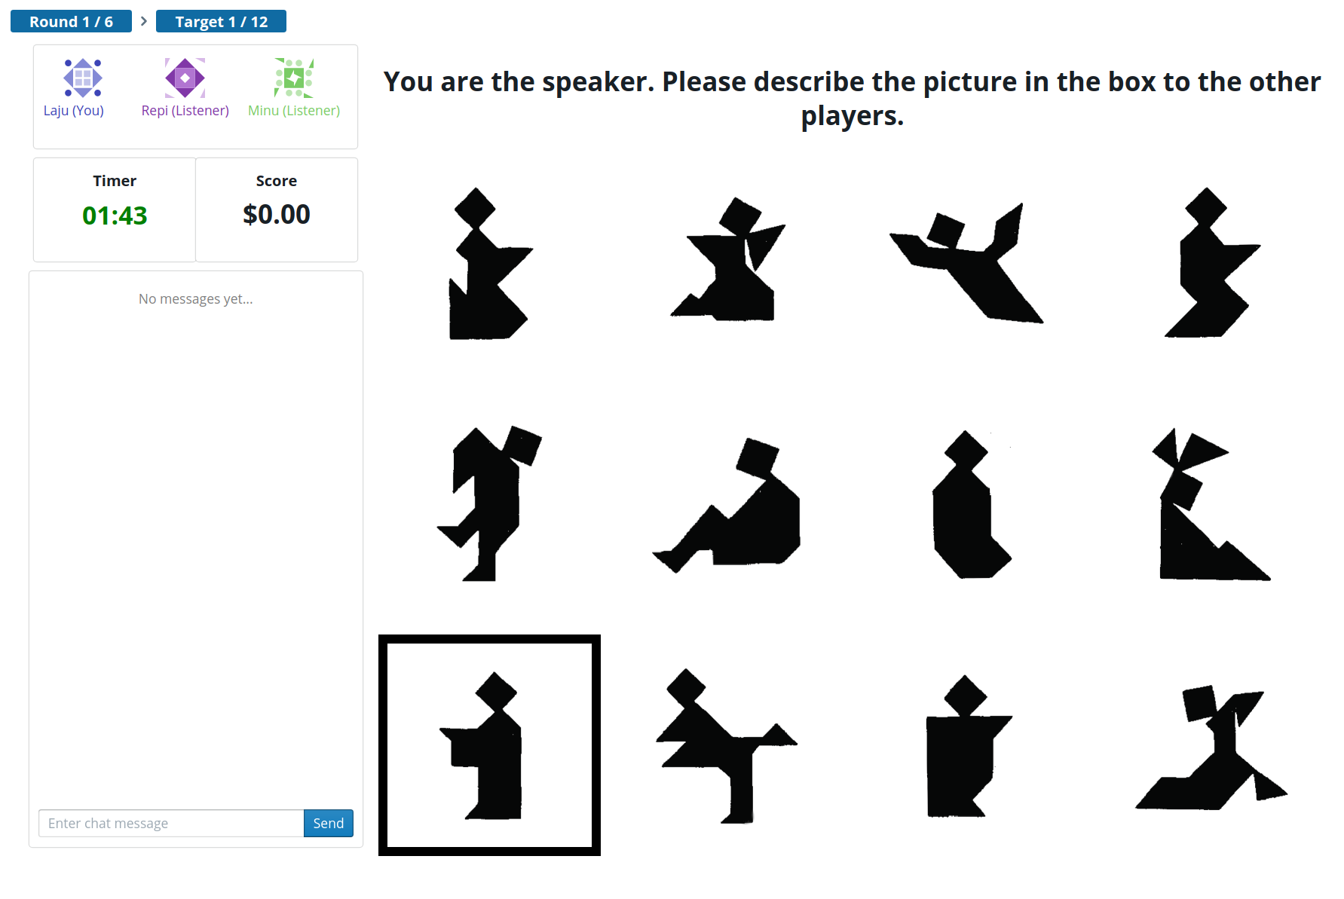
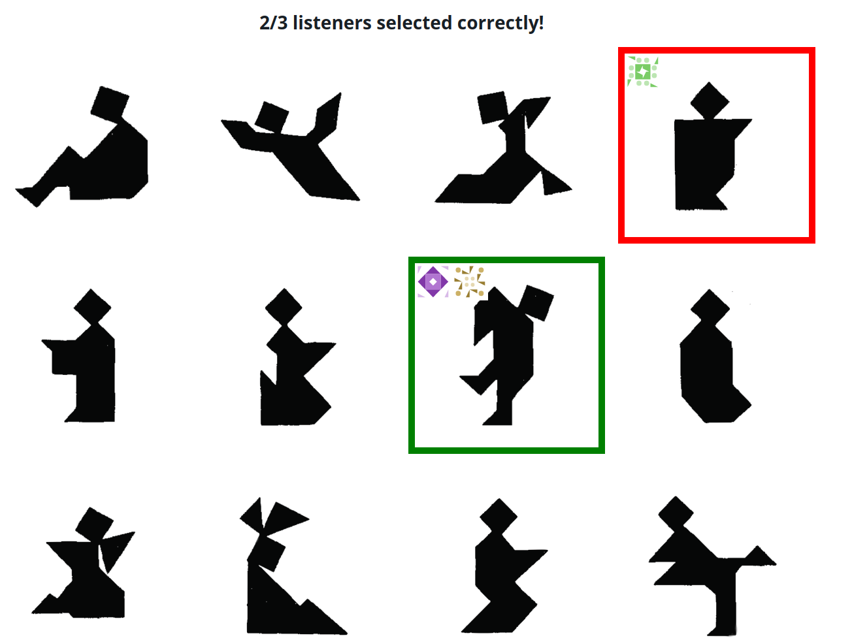
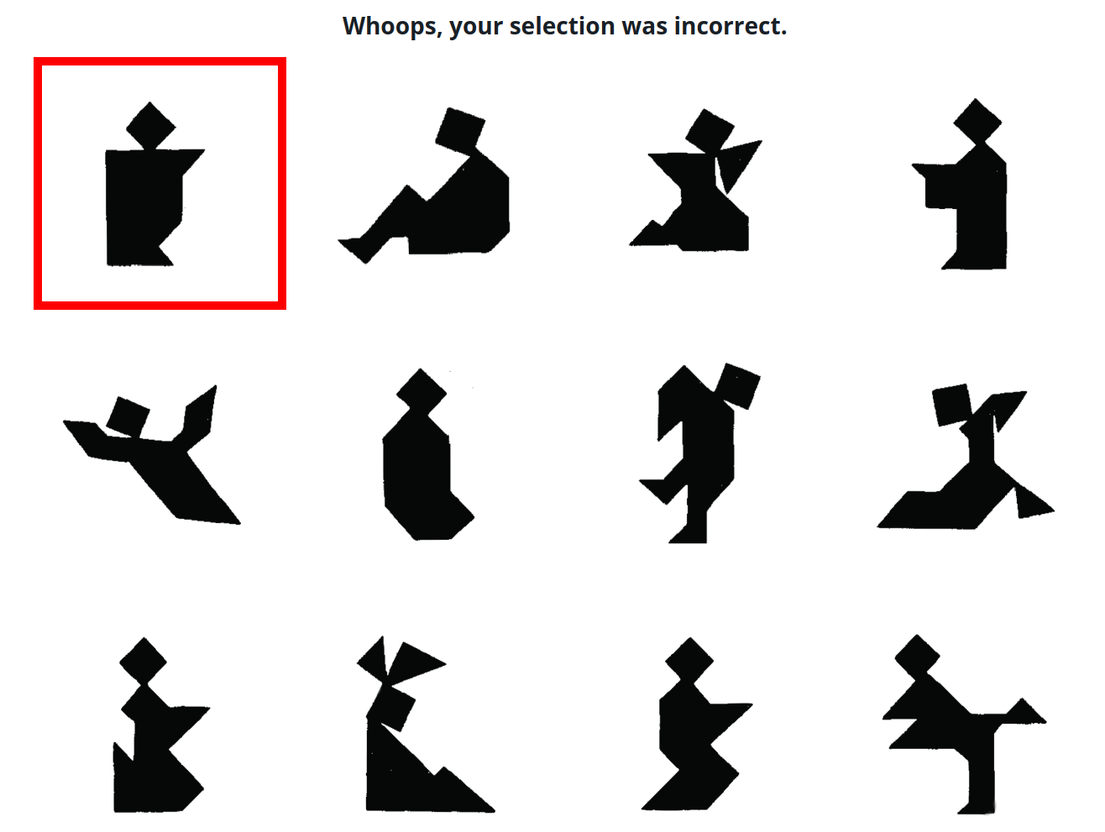
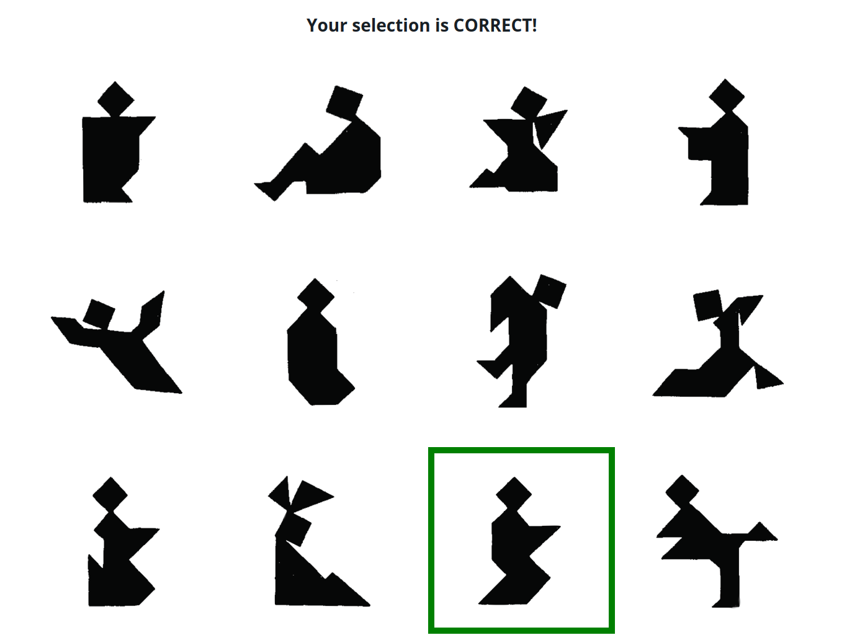
Methods: Prolific & Empirica
2/3 correct!
Incorrect!
Correct!
Almaatouq et al (2021)

Slide 22
Aimed for 20 games / condition.
Included all complete blocks, even if the game didn’t finish
Players | Complete | Partial
2 | 15 | 4
3 | 18 | 2
4 | 19 | 2
5 | 17 | 3
6 | 12 | 6

Slide 23
Statistical results:
correct.num ~ block * num.Players
block = .38 [.25, .5]; numPlayers=-.02 [ -.08,.03]; block:numPlayers=-.01[-.04,.01]
time ~ block * num.Players
block = -10.0 [-11.03, -9.03]; numPlayers=1.03 [ .4,1.66]; block:numPlayers=.29 [.07,.5]
words ~ block * numPlayers + (block|tangram) + (1|playerId) + (1|tangram_group) + (block|gameId)
block=-3.35 [-4.58, -2.13]; numPlayers=1.67 [.68, 2.71]; block:numPlayers=-.1 [-.39, .18]

Slide 24
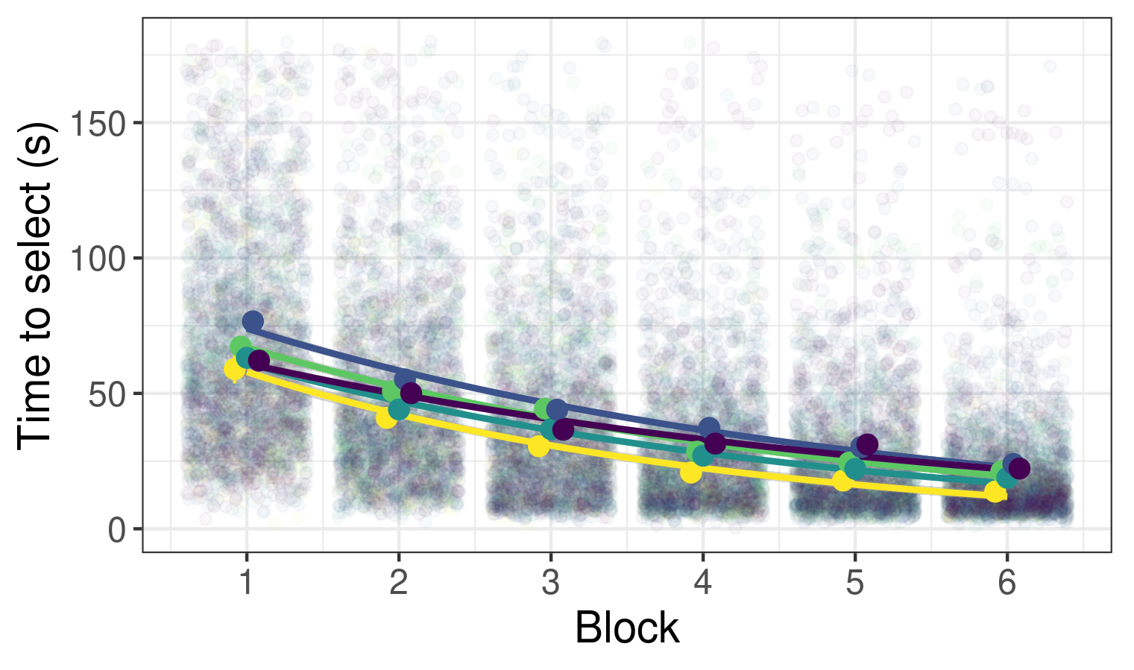
People choose faster in later rounds

Slide 25
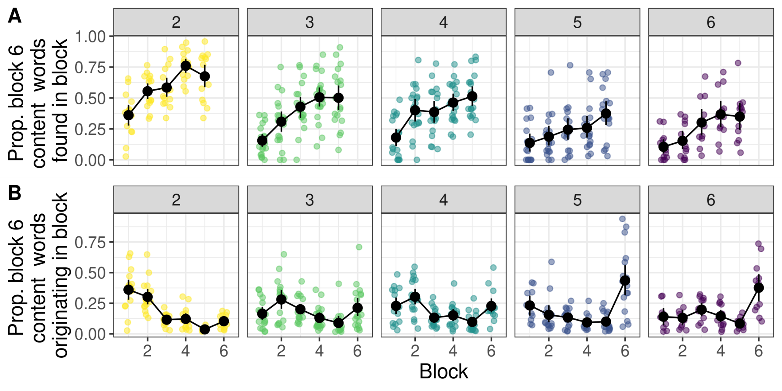
Nicknames originate earlier in smaller groups
overlap ~ block * numPlayers + same_speaker + (1 | gameId) + (1 | target)
block=.1[.08, .12] ; numPlayers=-.07 [-.09, -.04] ;block:numPlayers =0[-.01, 0]; same_speaker=.08 [.05, .1]

Slide 26
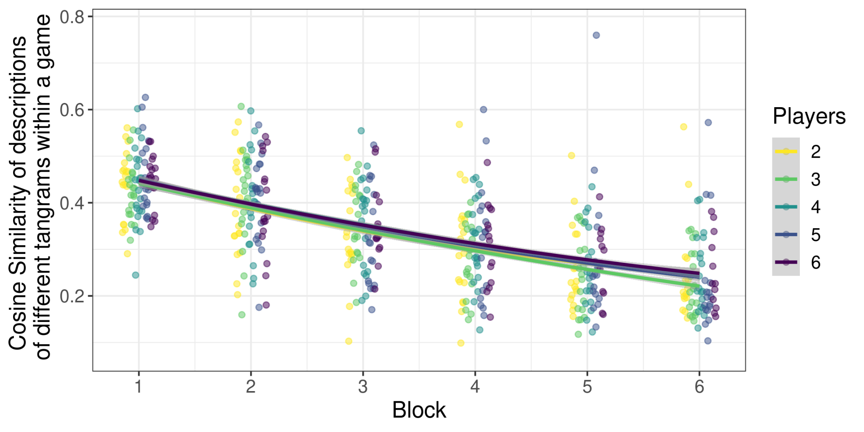
Descriptions diverge across tangrams

Slide 27
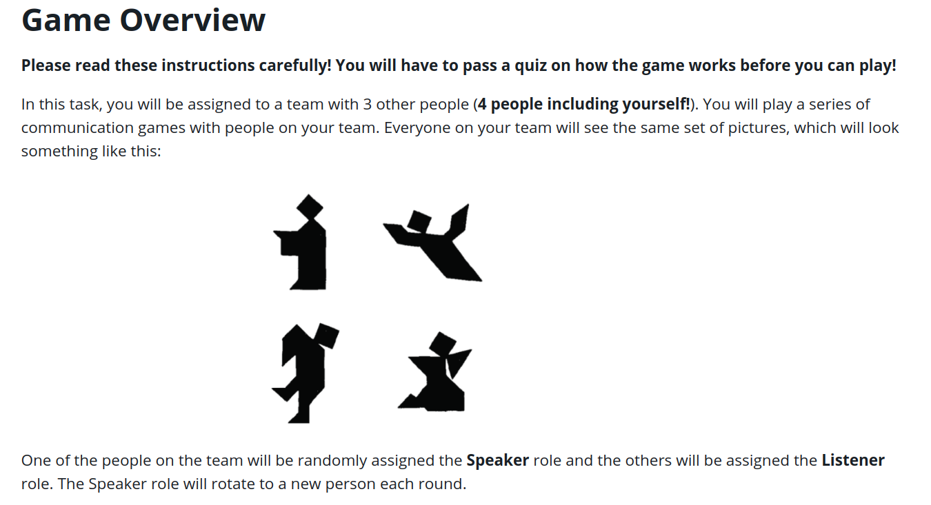

Slide 28
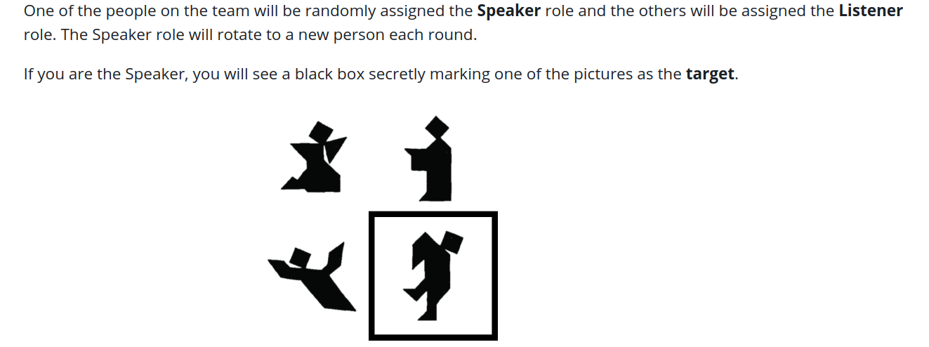

Slide 29
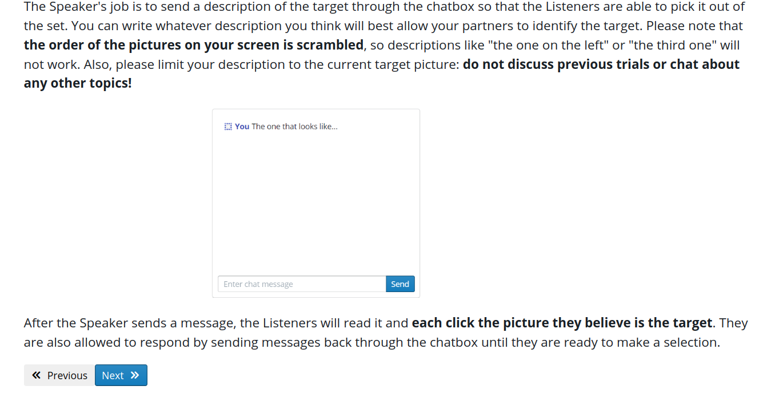

Slide 30
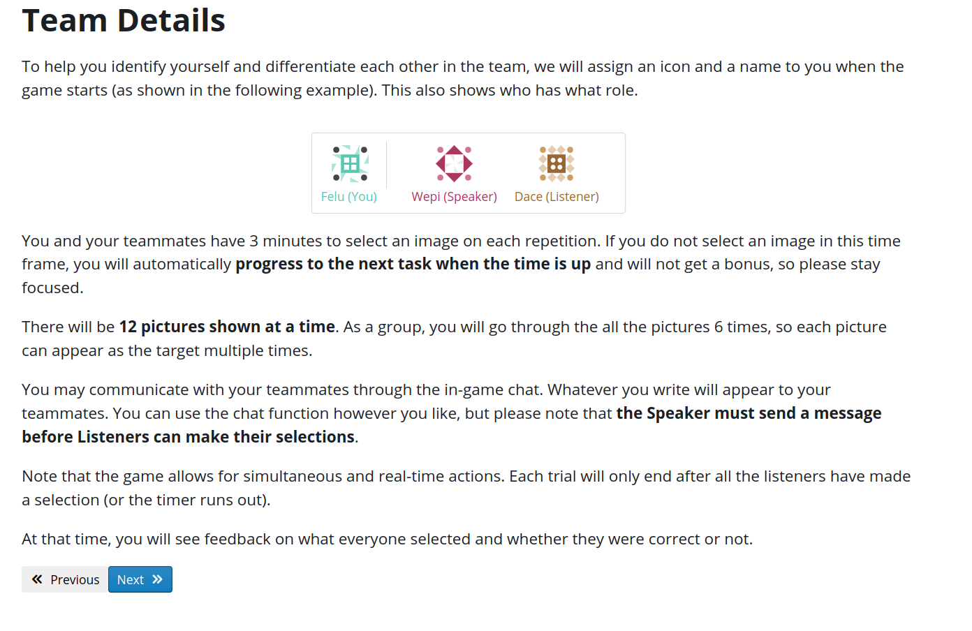

Slide 31
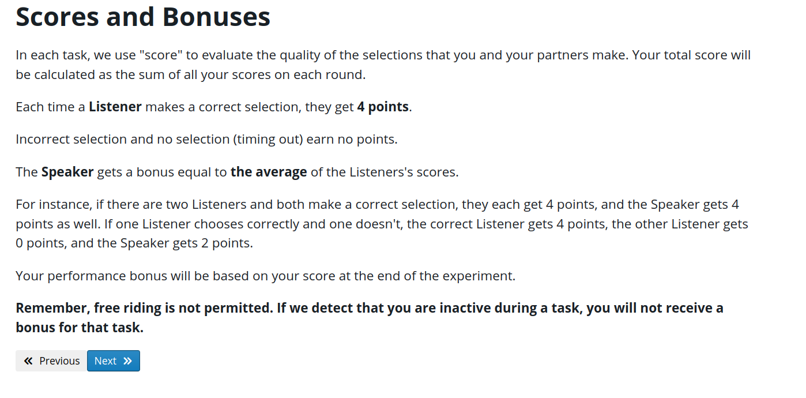

Slide 32
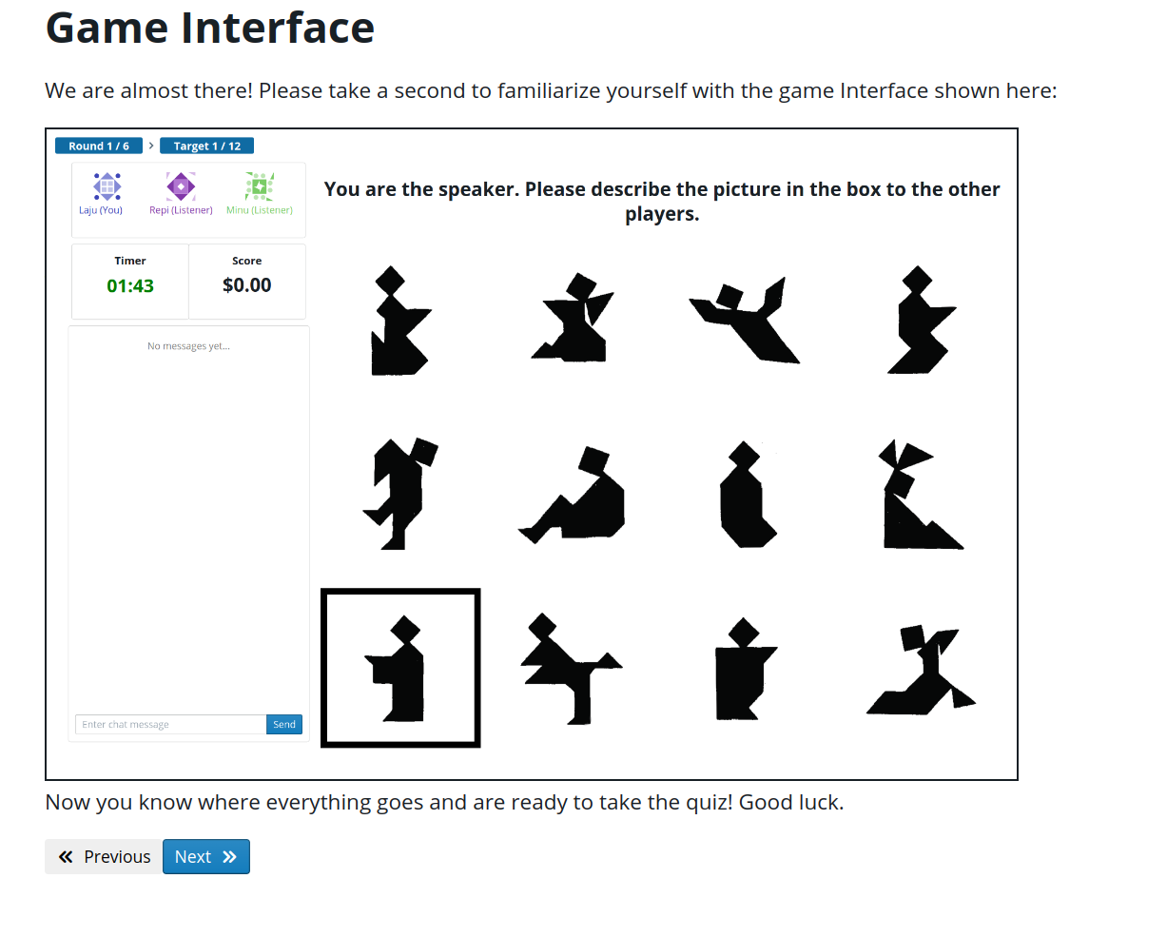

Slide 33
